Slide 1
Incremental Learning - 3
30/01
Pramit Kumar Bhaduri

Slide 2
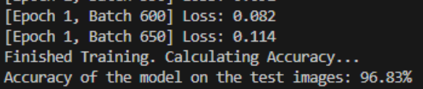
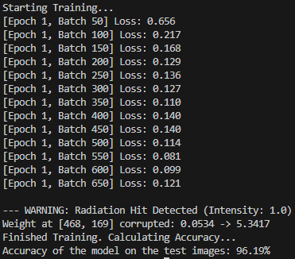
Initial fault model
Current method:
multiplies a weight by 100
This is a value corruption model, not a true “bit flip model”.
A true bit flip model would:
take the float32 number in memory
flip one of its 32 bits
convert back to float
sometimes the value barely changes
sometimes it becomes huge or NaN (if exponent bits flip)
V/S
Notes:
The key foundation for Phase 2 was implementing a fault model that matches what radiation does in memory: bit flips, not arbitrary scaling.”
Elaborate (facts grounded in our experiment):
“Originally, I tested a simple corruption that multiplied a weight by a constant. This doesn’t represent an SEU.”
“In actual hardware, radiation causes single event upsets (SEUs) that flip bits in stored values.”
“So I switched to a bit-flip injector that flips a random bit in a float32 IEEE-754 representation. This matters because the impact depends on which bit flips—some changes are tiny, others are catastrophic.”
“This corrected fault model is the basis for a defensible reliability experiment and aligns with how fault-injection studies are typically performed.”

Slide 3
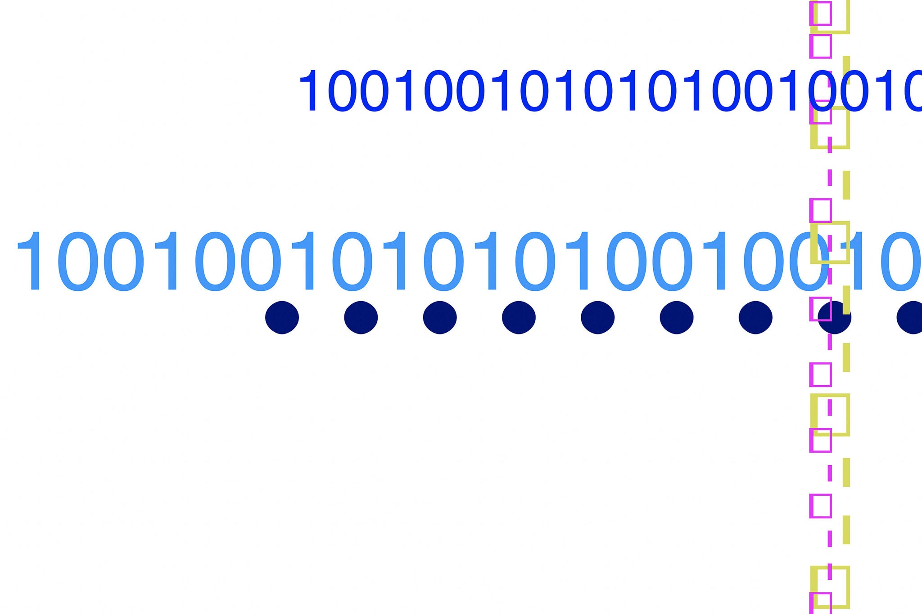
What is BER? (Bit Error Rate)
“probability that any stored bit flips from 0→1 or 1→0 due to radiation”
Why “bit” matters
Model weights are stored as numbers in memory.
If we store weights as float32:
Each weight = 32 bits
If we have N parameters:
  total bits stored = N * 32
Quick numerical feel
Suppose our model has ~5 million parameters (example scale).
float32 bits = 5,000,000 × 32 = 160,000,000 bits
If BER = 10^−9
Expected flips ≈ 0.16 flips → usually 0 or 1 flip
If BER = 10^−7
Expected flips ≈ 16 flips → corrupting many weights
So BER acts like a knob for “space harshness”
Notes:
“To simulate different space environments, we need a knob that controls how many bit flips occur. That knob is BER.”
Elaborate (facts grounded in our experiment):
“BER (Bit Error Rate) is a probability measure that represents how frequently bits flip due to radiation.”
“In our implementation I used per-parameter BER mode (inspired from the script I got from you) where:
faults/run = BER × number of parameters.”
“Our ViT has 5,526,346 trainable parameters, so BER directly maps to expected faults per run. For example:
BER=1e-6 → ~5 faults
BER=1e-5 → ~55 faults
BER=1e-4 → ~552 faults.”
“This mapping is important for interpretability: each BER value corresponds to a specific fault load we inject into the model.”

Slide 4
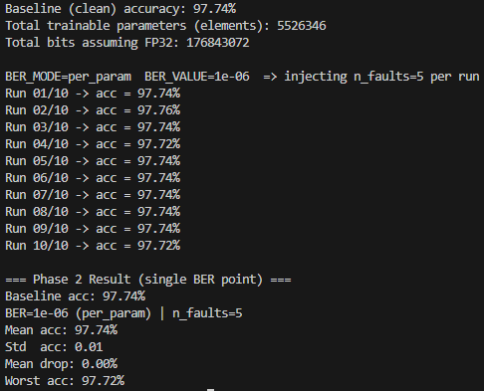
Phase 2: Bit-Flip Fault Injection (Minimal Working)
Load trained ViT-Tiny EuroSAT checkpoint (vit_eurosat_clean.pth)
Baseline evaluation on test set
Fault model: random SEU bit-flips
  choose random parameter (entire model)
  choose random element
  flip 1 random IEEE-754 float32 bit
BER definition: per-parameter
  n_faults=BER×#params
Monte-Carlo repetitions: 10 runs per BER point
Setup numbers
Total trainable parameters: 5,526,346
BER = 1e-6 → 5 injected faults/run
Conclusion
Low fault rate causes negligible degradation → next: BER sweep to observe failure curve.
Notes:
This slide demonstrates that Phase 2 is implemented correctly: starting from a clean checkpoint, injecting faults, and measuring the post-fault accuracy.”
Elaborate (facts grounded in our experiment):
“I load the clean checkpoint and measure baseline accuracy: 97.74%.”
“Then we inject a controlled number of bit flips into random parameters across the whole model.”
“We validated the pipeline at BER=1e-6 (~5 faults/run) in early tests and saw almost no change in some runs, confirming injection doesn’t automatically break the model every time.”
“The key point is that the pipeline is repeatable: we always reset to the same clean checkpoint before each injected run.”

Slide 5
Next, Monte-Carlo Reliability Sweep
Baseline: load clean checkpoint (trained ViT-Tiny) and measure test accuracy.
Fault model: inject random IEEE-754 bit flips into random model parameters (global injection across the network).
Monte-Carlo method: for each BER value
reset to clean checkpoint
inject N faults (derived from BER)
evaluate on test set
repeat 20 independent trials
Reported metrics: mean accuracy, std deviation, worst-case accuracy per BER.
Notes:
The reason we use Monte-Carlo is because radiation faults are random—so reliability must be measured statistically, not with a single run.”
Elaborate (facts grounded in our experiment):
“For each BER value, we run multiple independent trials (e.g., 20 or 50). Each trial starts from a clean checkpoint and injects a different random fault pattern.”
“We summarize outcomes with mean accuracy, standard deviation, and worst-case accuracy.”
“This is crucial because we observed very large variance in the knee region: the mean may still look acceptable, while worst-case collapses.”
“This Monte-Carlo approach lets us compute reliability metrics like P(accuracy < threshold), which is more meaningful for safety-critical systems.”

Slide 6
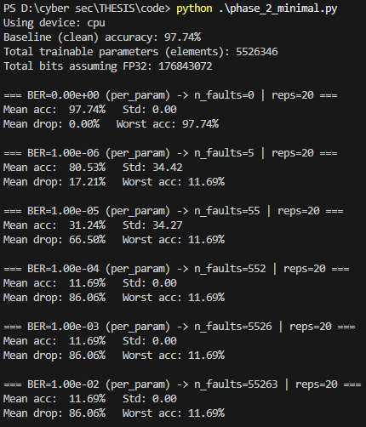
results
Clean baseline: 97.74% accuracy (BER = 0 → no faults, stable).
Rapid degradation with higher BER: accuracy drops sharply as injected faults increase.
Failure floor: from BER ≥ 1e-4 (≈552+ faults/run), accuracy collapses to 11.69% consistently (std ≈ 0).
Critical “knee” region: BER = 1e-6 to 1e-5 shows large uncertainty—sometimes near-normal accuracy, sometimes catastrophic failure.
Takeaway: model is high-performing when healthy, but not dependable under random SEU-style faults → motivates repair/mitigation (Phase 3).
Notes:
These results show the overall reliability pattern: stable baseline, sharp degradation with BER, and a collapse floor.”
Elaborate (facts grounded in your output):
“Baseline accuracy is 97.74% (BER=0).”
“At BER=1e-6, results can vary dramatically across trials: we saw mean around 80% in the coarse sweep with a very large std, and worst-case reaching ~11.69%.”
“At BER=1e-5, mean accuracy dropped further (around 31%) and worst-case still hit the same collapse floor.”
“From BER ≥ 1e-4, accuracy becomes 11.69% with std = 0, meaning every run collapses the same way.”
“This clearly identifies the knee region: around 1e-7 to a few e-6 where failures start appearing but are not guaranteed.”
Your script gave me the correct Monte-Carlo reliability structure: reset, inject random faults, sweep BER, repeat. I adapted it to ViT in PyTorch, replaced the fault model with IEEE-754 bit flips, refined the BER grid to the knee region, and added failure-probability metrics. The core methodology is directly based on your script.

Slide 7
BER = 1e-6 (~5 faults/run): Same BER, Diff. Outcome
At BER = 1e-6, we inject only ~5 random bit flips per run → results depend heavily on where the faults land.
Previous run: faults likely hit low-impact bits/parameters → accuracy remained near baseline.
This sweep: some trials hit high-impact locations → accuracy dropped strongly (mean ≈ 80.53%, worst ≈ 11.69%).
Why this happens (IEEE-754 bit flips):
Harmless flips: mantissa (fraction) bit flips → small numeric change → minimal effect on predictions.
Dangerous flips: exponent/sign bit flips → huge numeric change (orders of magnitude) → unstable activations/logits.
If logits become extreme or invalid (NaN/Inf), the model can output a constant class → accuracy collapses to a “floor”.
Takeaway:
BER=1e-6 is in a rare-catastrophe regime: average performance may look okay, but reliability is dominated by low-probability worst cases.
Notes:
This explains a key reliability phenomenon: the same BER can look harmless in one run and catastrophic in another.”
Elaborate (facts grounded in our experiment + IEEE-754 reasoning):
“At BER=1e-6, we inject only about 5 faults/run, which is extremely small compared to 5.5M parameters.”
“Because the number of faults is small, outcomes are dominated by where the faults land. Some trials hit low-impact bits/parameters and accuracy stays high; other trials hit sensitive locations and accuracy collapses.”
“This is reflected in the large standard deviations we observed in the knee region (std values ~20–35 in our sweeps).”
“This is why reliability must be expressed as probability of failure, not just mean accuracy.”

Slide 8
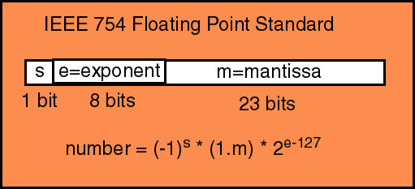
IEEE-754 Float32: understanding the parts
Model weights are stored as 32-bit floats (float32) using the IEEE-754 format.
A float32 is split into:
Sign (1 bit) → flips the value’s sign (+/−)
Exponent (8 bits) → controls the scale (can change value by orders of magnitude)
Mantissa (23 bits) → controls small precision changes
Key idea:
Mantissa flips often cause small changes → sometimes accuracy stays high
Exponent/sign flips can cause huge changes → can collapse predictions
Notes:
To understand why some faults barely matter while others destroy accuracy, we need one slide on how float32 numbers are stored.”
Elaborate (facts grounded in bit-flip behavior):
“float32 stores a number as sign (1 bit), exponent (8 bits), and mantissa (23 bits).”
“Flipping a mantissa bit usually creates a small numeric change—often the model still works.”
“Flipping an exponent bit can change the value by orders of magnitude, which can destabilize activations and logits.”
“This matches our observed knee behavior: a few faults may be harmless, but a single unlucky exponent/sign flip can trigger a catastrophic collapse.”

Slide 9
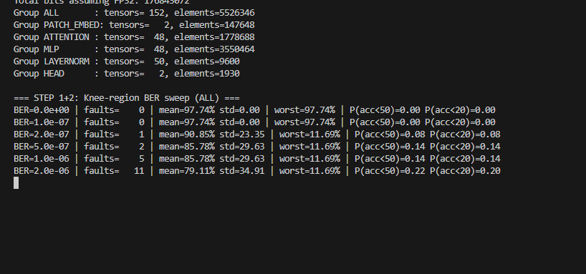
What next? a “Knee-Region” BER Sweep
Full BER sweep showed a cliff: low BER ≈ fine → higher BER = collapse floor
We target the knee region where:
accuracy sometimes stays high
sometimes fails catastrophically
Purpose: capture the transition to failure with higher resolution
Practical mapping (per-param mode):
faults/run = BER × #params (≈ 5.5M params)
Notes:
“After the first full BER sweep, the next step was to focus on the ‘knee’—the region where the model transitions from mostly correct to frequent catastrophic failures.”
Elaborate (facts grounded in our experiment):
“In the coarse sweep, BER=0 stayed stable at 97.74% accuracy with std = 0, confirming the evaluation pipeline is deterministic when no faults are injected.”
“At higher BER values like 1e-4 and above, the model consistently collapsed to ~11.69% accuracy with std = 0, which indicates we reached a ‘failure floor’ where the model is essentially non-functional in every trial.”
“That means large BER steps (like 1e-4 → 1e-3 → 1e-2) don’t add new information—everything past the collapse point behaves the same.”
“The informative part is the transition region, where accuracy can still be high in some trials but collapses in others. That is exactly what we need for dependability, because satellites care about worst-case and failure probability, not only averages.”
“So the knee sweep is about increasing resolution around the point where failures begin, to build a reliable curve and quantify failure risk.”

Slide 10
How to further refine BER values
Stage 1 (coarse sweep): locate failure regimes
example: 0, 1e-6, 1e-5, 1e-4, … → found knee + collapse floor
Stage 2 (knee sweep): densify around the transition
0, 1e-7, 2e-7, 5e-7, 1e-6, 2e-6, …
Stage 3 (final plot grid): add extra points inside knee
1.5e-7, 3e-7, 7e-7, 1.2e-6, 1.5e-6, 1.8e-6, …
Notes:
“In the next test, BER values weren’t chosen randomly — I refined them step-by-step based on what the previous sweep revealed.”
Elaborate (facts grounded in our experiment):
“Stage 1 was a coarse sweep to locate regimes: baseline at BER=0, a high-variance knee at low BER, and a collapse floor at higher BER.”
“Stage 2 densified around the knee (e.g., 1e-7 → 2e-6) because that’s where failures first appear and variability becomes large.”
“Stage 3 was about adding extra points inside the knee (e.g., 1.5e-7, 3e-7, 7e-7, 1.2e-6, 1.5e-6, 1.8e-6) so the reliability curve is smooth and plot-ready.”
“This is also a compute strategy: I spend trials where behavior changes to identify the key regions.”

Slide 11
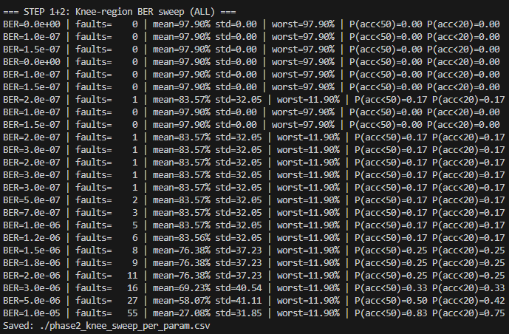
Phase 2 Upgrade: Knee Sweep + Failure Probability
Switched from coarse BER sweep → knee-region sweep (denser BER points)
Added failure probability metrics:
P(acc < 50%) = “mission failure rate”
P(acc < 20%) = “catastrophic failure rate”
Accelerated runtime using:
subset test set (N=1000)
12 Monte-Carlo trials per BER
Result: identified knee region where rare catastrophes start and failure rate grows with BER
Notes:
After the first sweep showed a cliff, I refined Phase 2 to get a plot-ready reliability curve.”
Elaborate (facts grounded in our output):
“The earlier coarse sweep showed two extremes: stable baseline at BER=0 and a collapse floor at higher BER.”
“To capture the transition properly, I added more BER points around the knee, where failures start appearing.”
“In per-param mode, we compute faults/run = floor(BER × #params). With ~5.5M parameters:
BER=2e-7 → ~1 fault/run
BER=1e-6 → ~5 faults/run
BER=1e-5 → ~55 faults/run.”
“Because bit flips are random, I use Monte-Carlo trials per BER and now report reliability as probability: P(acc<50) and P(acc<20).”
“Observed trend: as BER increases, mean accuracy drops and failure probabilities increase.”
“Example: by BER=5e-6 (~27 faults/run), P(acc<50)≈0.50.”
“At BER=1e-5 (~55 faults/run), mean accuracy drops to ~27% and P(acc<50)≈0.83.”
“This upgraded sweep gives us a knee-region reliability curve that i can now use to motivate Phase 3 repair.”

Slide 12
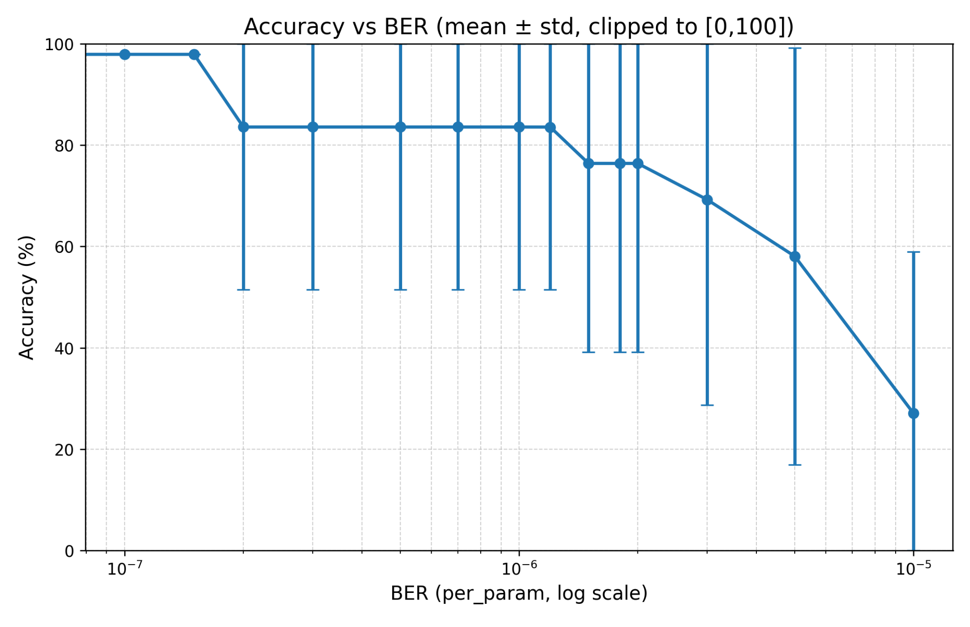
Plot 1 — Accuracy vs BER (mean ± std)
Notes:
“Plot 1 shows how average accuracy degrades as BER increases, and how unstable the model becomes in the knee region.”
Elaborate (facts grounded in the plot / output):
“X-axis is BER in log scale; Y-axis is mean test accuracy across 12 Monte-Carlo trials per BER.”
“The error bars represent variability (std). Large error bars indicate that outcomes depend strongly on where the random bit flips land.”
“At very low BER (≤1e-7), faults/run rounds to zero, so accuracy stays at baseline (~97.9%).”
“Once we reach the knee (≈2e-7 to 2e-6), the mean drops to ~83–76% and the std becomes very large (~32–37%), meaning some trials remain near-normal while others collapse.”
“At higher BER values (e.g., 5e-6 and 1e-5), the mean accuracy drops further (~58% then ~27%), showing the system becomes increasingly unreliable under heavier fault loads.”
“Key takeaway: mean accuracy alone is not enough; variance shows why we also need failure probabilities.”

Slide 13
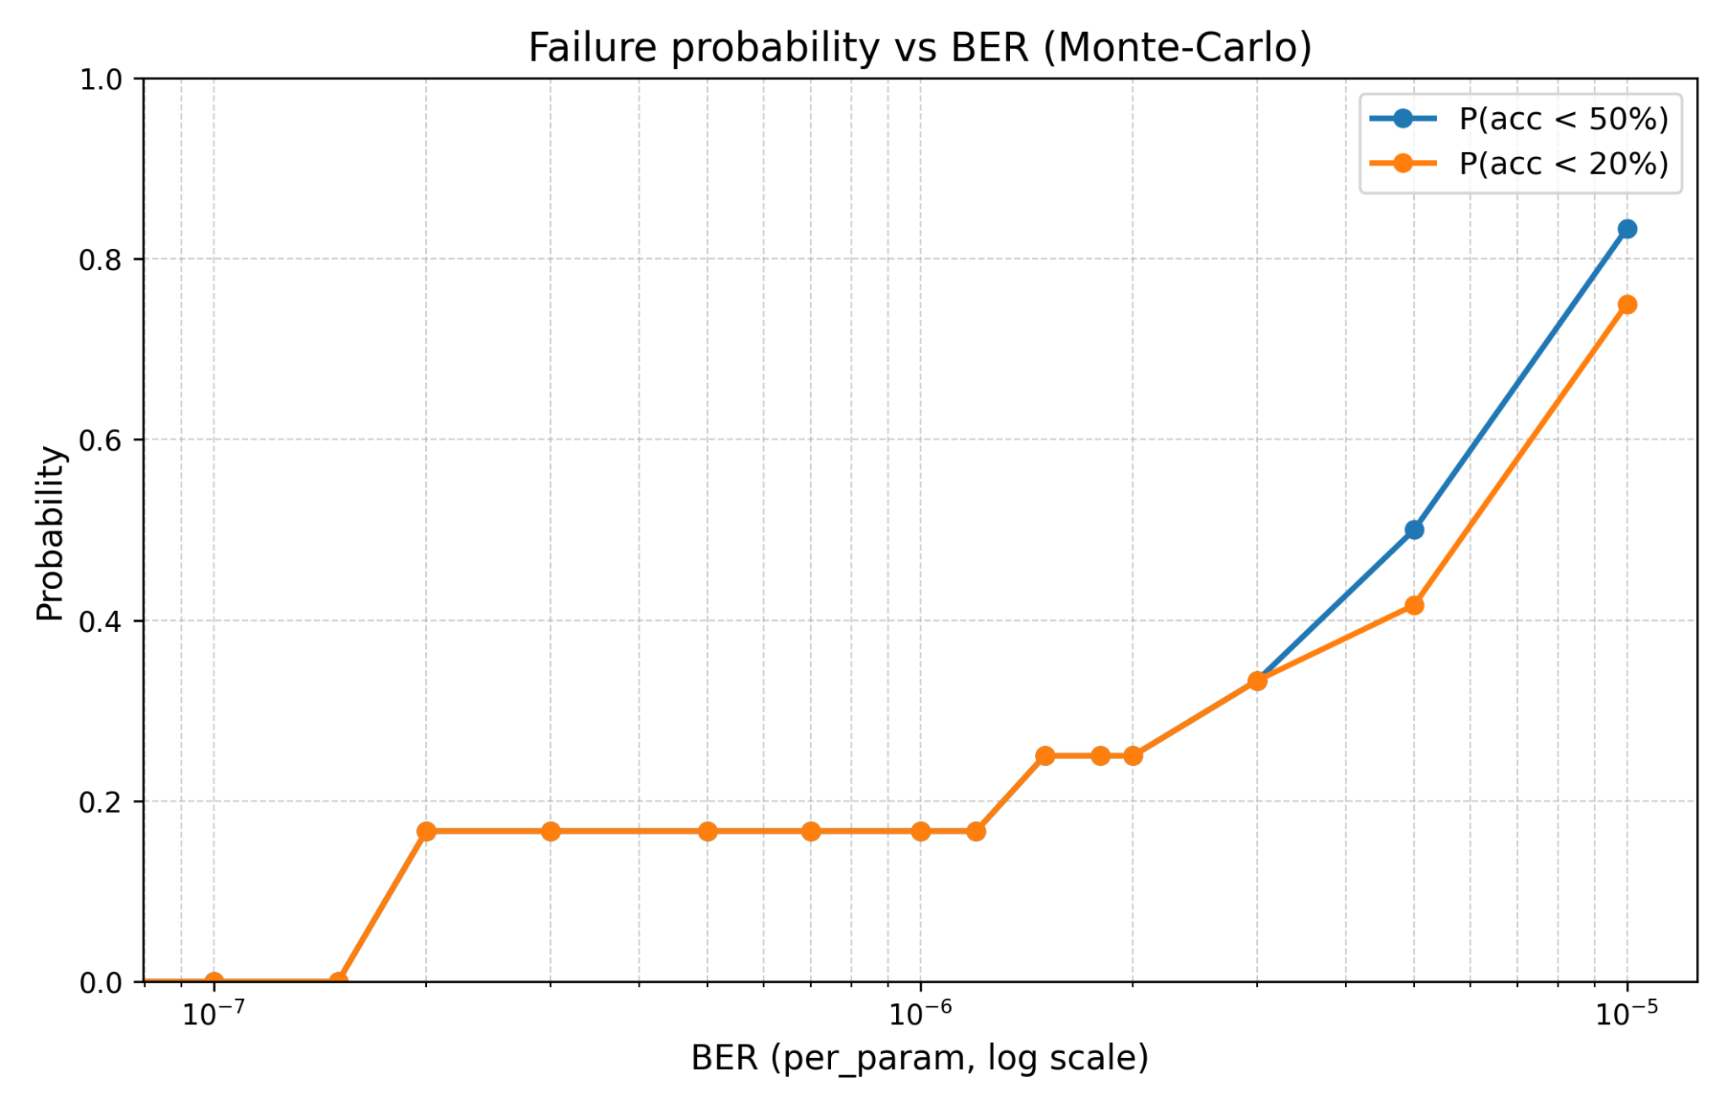
Plot 2 — Failure Prob. vs BER (Monte-Carlo Reliability)
Notes:
This plot translates the same experiments into a reliability metric: how often the model becomes unacceptable.”
Elaborate (facts grounded in the plot / output):
“I define two failure thresholds:
P(acc<50%) = mission-level failure
P(acc<20%) = catastrophic failure.”
“At very low BER, both probabilities are near zero because there are effectively no injected faults per run.”
“Starting around BER≈2e-7 (~1 fault/run), failure probability becomes non-zero: we begin seeing rare catastrophic outcomes.”
“In the knee region, the failure probability rises gradually:
around BER=3e-6 (~16 faults/run), P(acc<50)≈0.33
at BER=5e-6 (~27 faults/run), P(acc<50)≈0.50.”
“At BER=1e-5 (~55 faults/run), failure becomes dominant: P(acc<50)≈0.83 and catastrophic failures also rise strongly.”
“Key takeaway: this curve is the dependability story—radiation faults don’t just reduce accuracy; they increase the probability of unacceptable outcomes.”

Slide 14
Next steps
Phase 2 (final): rerun knee sweep on full test set with more trials
Component analysis: identify which parts of ViT are most fault-sensitive
and then..
Phase 3: start implementing repair (LoRA/QLoRA) + show recovery and improved reliability
Notes:
Now that i have a working reliability curve, the next steps are about (1) making the results statistically stronger, (2) understanding where the model is most vulnerable, and (3) showing a repair mechanism.”
Elaborate:
“First, i will rerun the knee-region sweep using the full test set and more Monte-Carlo trials (e.g., 50–100). This should reduce sampling noise and gives better reliability curves.”
“Second, i’ll do component analysis. A Vision Transformer is made of different functional blocks, and a bit flip in one block can be far more damaging than in another.”
“Examples of components:
Patch embedding (converts image patches into tokens)
Attention layers (global mixing of information across patches)
MLP layers (large feed-forward layers with many parameters)
LayerNorm (stabilizes activations)
Classifier head (final class decision)”
“In component analysis, i inject the same number of faults but restrict where they land, then compare reliability metrics like P(acc<50%). This tells us which part is most sensitive.”
“And then, we move to Phase 3: to implement a repair method using LoRA/QLoRA. The goal is to take a corrupted model from the knee region and recover performance without retraining the whole network.”

